Slide 1
IMDb Web Scraper
Drew Dinkel

Slide 2
Idea Behind The Project

Slide 3
Issues I Ran Into

Slide 4
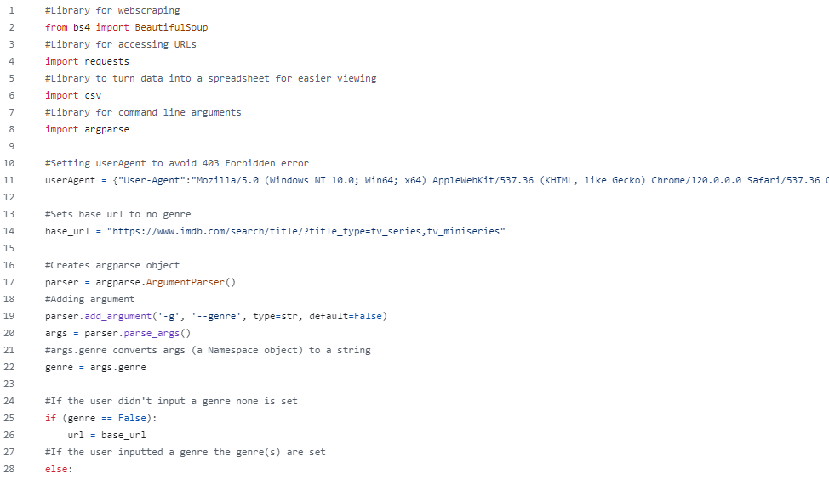

Slide 5
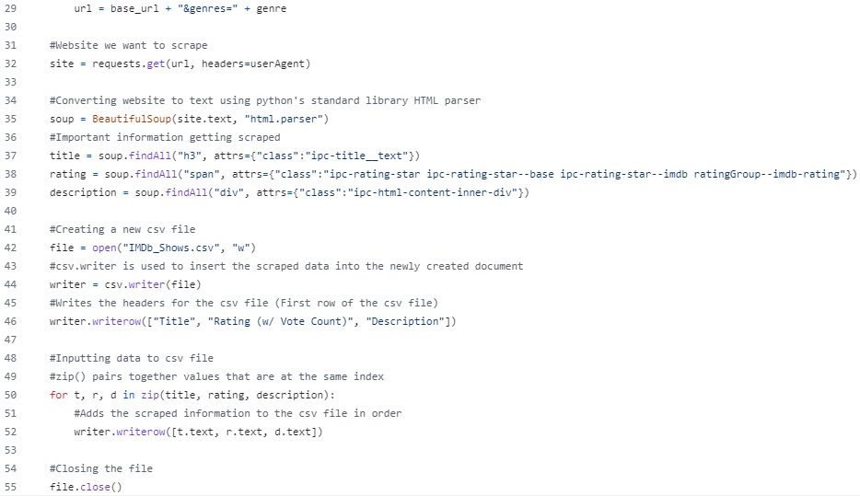

Slide 6
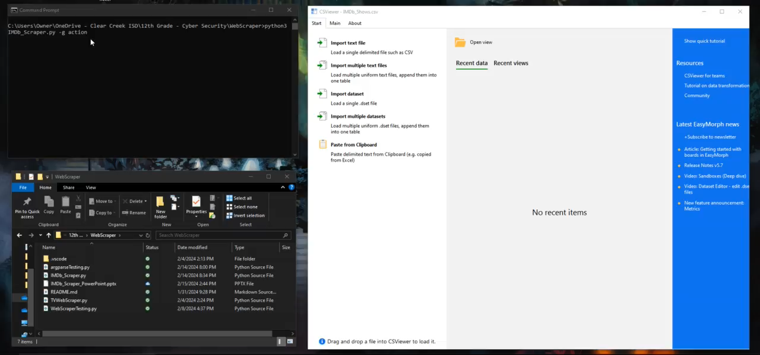

Slide 7
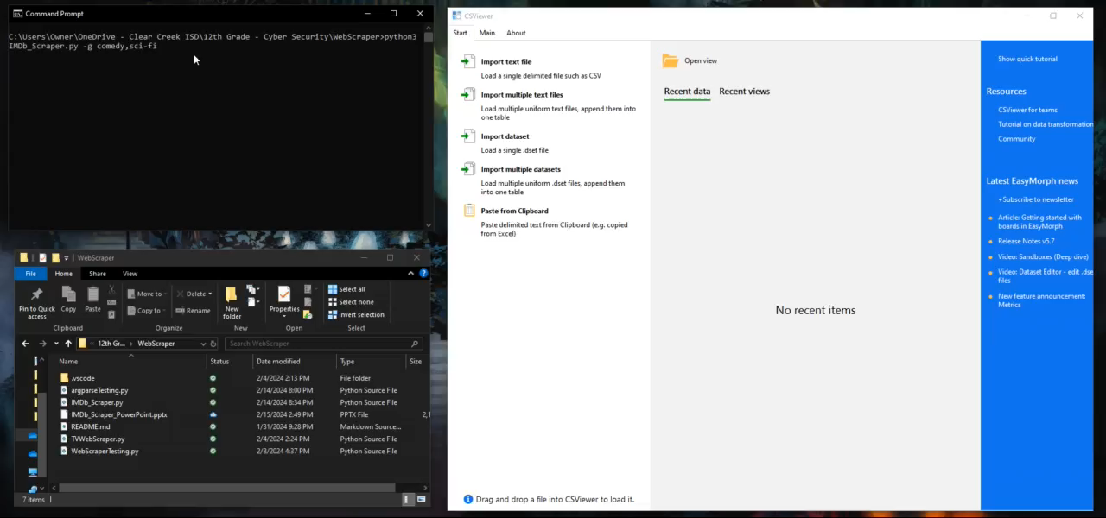

Slide 8
Sources

Slide 9


Questions

